Slide 1
V3.1.0
New Features and Processes

Slide 2
Enhancements
Sales Functionality
Invoice
Hold & Layaway
Cashout Process
Cashout Report
Inventory Home Page

Slide 3
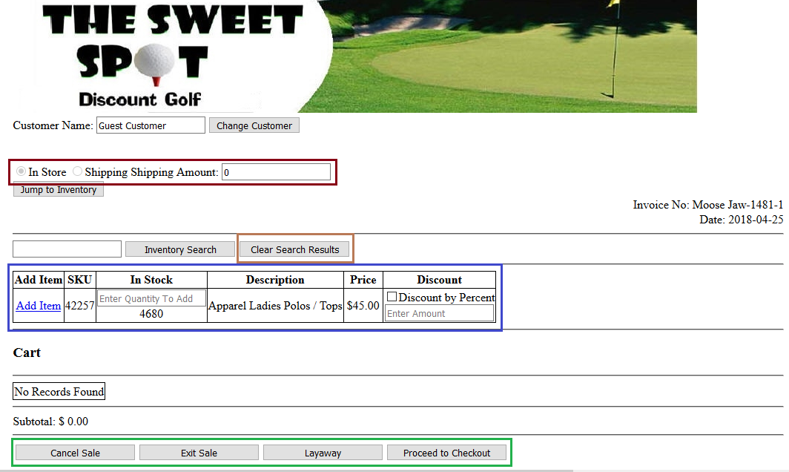
Sales Functionality
When in a Sale there is some new functionality that you will notice. The first to make note of is the is that the In Store and Shipping radial buttons are no longer functional. To charge shipping change the amount in the shipping box to anything other than $0.00. This will automatically switch the radial button from In Store to Shipping. Changing the amount back to $0.00 will reverse the radial button change. (Dark Brown)
Next will be the Clear Search Results button, this will essentially just as the name suggests clear the grid of previously searched items showing no results. (Light Brown)

Slide 4
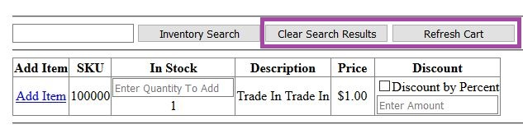
Sales Functionality Cont.
A button was added that will allow you to refresh the cart. The reason for this is because a trade-in item will not show unless the cart is refreshed. This button will only appear when a trade-in is added to the cart and will disappear once it is clicked. (Purple)
Adding items to the cart has changed a little bit. The first thing to take note of is you can now select the quantity of the item before you add it. This is under the In Stock header. If you are only adding 1 item, you can leave it blank. Below the textbox is a number. This shows the remaining quantity before you add the item. The next change is that prior to adding the item to the cart, you can set its discount. If you do not want to have a discount applied, leave the box blank. (Blue)

Slide 5
Sales – On Hold & Layaway
During a sale, you can now put it on hold by clicking the Exit Sale button. This will allow you to come back to the sale at a later point. (Green)
If the sale is a layaway, you are able to mark it as such by clicking the Layaway button located on the cart, and checkout page. (Green)

Slide 6
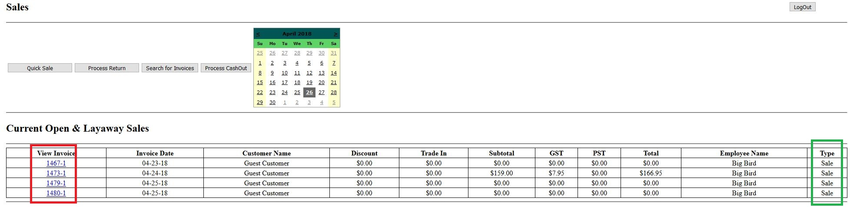
Sales – On Hold & Layaway Cont.
Sales that are on hold or are a layaway are shown on the sales homepage. To determine which sales are layaways and which are on hold sales, the right most column (Green) will let you know its type.
Resuming one of these sales can be done by clicking on the invoice number. Similar to viewing an invoice on the home page. (Red)

Slide 7
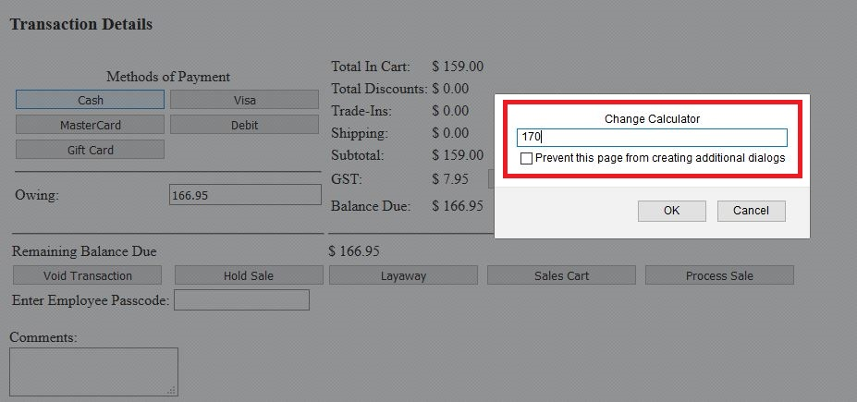
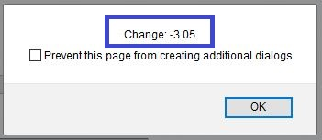
Sales – Change and Tender
This only affects Cash.
When using the cash method of payment, the second popup is a change calculator. Its purpose is to allow you to give back the proper amount of change, if any, without using a calculator. To use the change calculator, enter in the amount of cash that they gave you and it will display the amount of change owed.
In this example, a customer has given you $170 cash. You then enter the 170 into the calculator and press OK. (Red) It will then display the change owing, $3.05. (Blue)

Slide 8
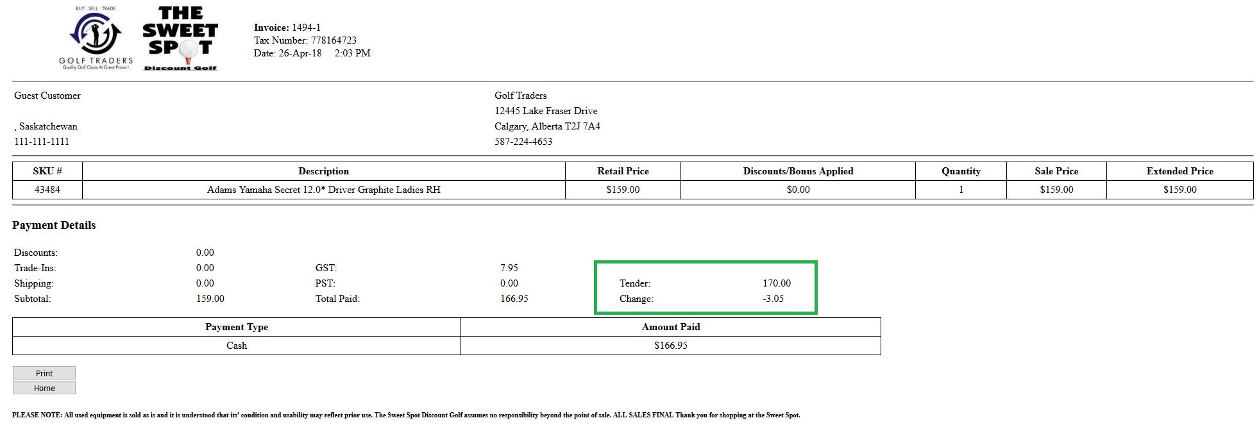
Sales – Change and Tender Cont.
The invoice will now show the tender and the amount of change given back to the customer. (Green)

Slide 9
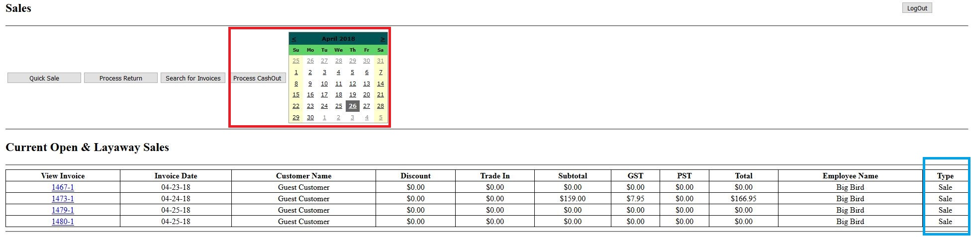
Cashout Process
The process of doing a cashout has changed slightly. It is no longer located on the Reports page, but is can now be found on the Sales page. To start a cashout, you need to confirm that there are no on going sales. (Blue) If there are none, select the date for the cashout and then press the Process CashOut button. (Red)

Slide 10
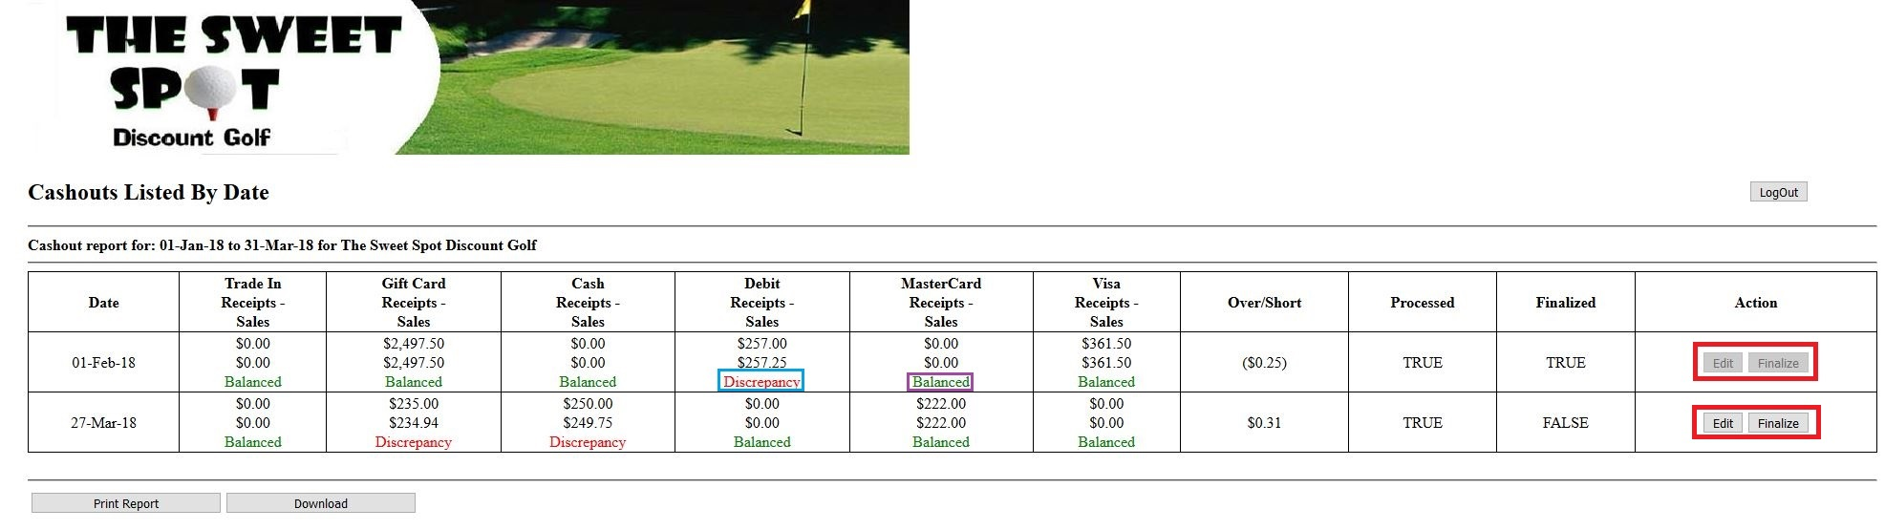
Cashout Report
A new report has been created which will allow you to review previous Cashouts. You can choose to edit an unfinalized cashout, which will take you to a prepopulated cashout sheet, or you can finalize the report which will remove the ability to edit it. (Red) If there is a mismatch in the data, the word Discrepancy will appear in a red font. (Blue) Otherwise it will say Balanced. (Purple)

Slide 11
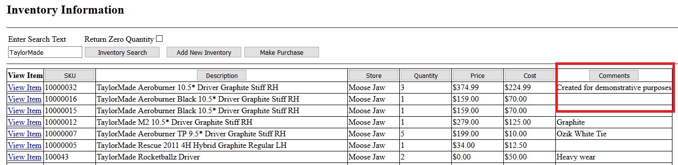
Inventory Homepage
Comments now have their own column in the inventory homepage. Along with that, you can now sort by comments. (Red)

Slide 12
Bug Fixes
The trade-in amount is now being properly applied to the Extensive Invoice report
Invoice will use less paper when printing as a few minor changes to the font size and placement were made

